Slide 1
DHCP协议

Slide 2
DHCP: Dynamic Host Configuration Protocol
Goal: allow host to dynamically obtain its IP address from network server when it joins network
Can renew its lease on address in use
Allows reuse of addresses (only hold address while connected an “on”)
Support for mobile users who want to join network (more shortly)
DHCP overview:
host broadcasts “DHCP discover” msg
DHCP server responds with “DHCP offer” msg
host requests IP address: “DHCP request” msg
DHCP server sends address: “DHCP ack” msg

Slide 3
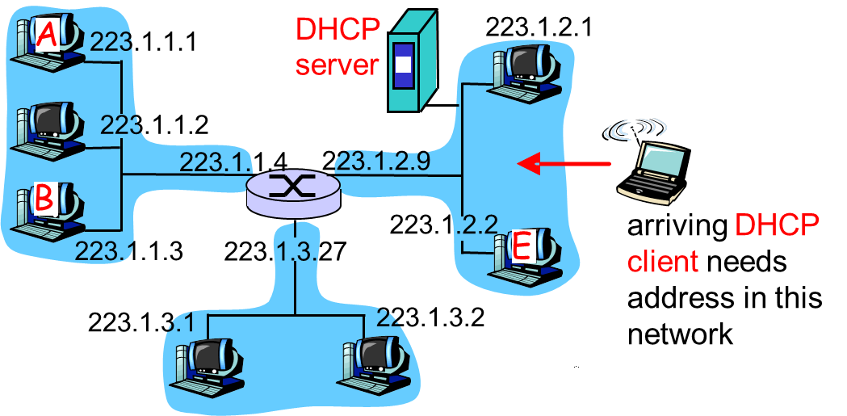
DHCP client-server scenario

Slide 4
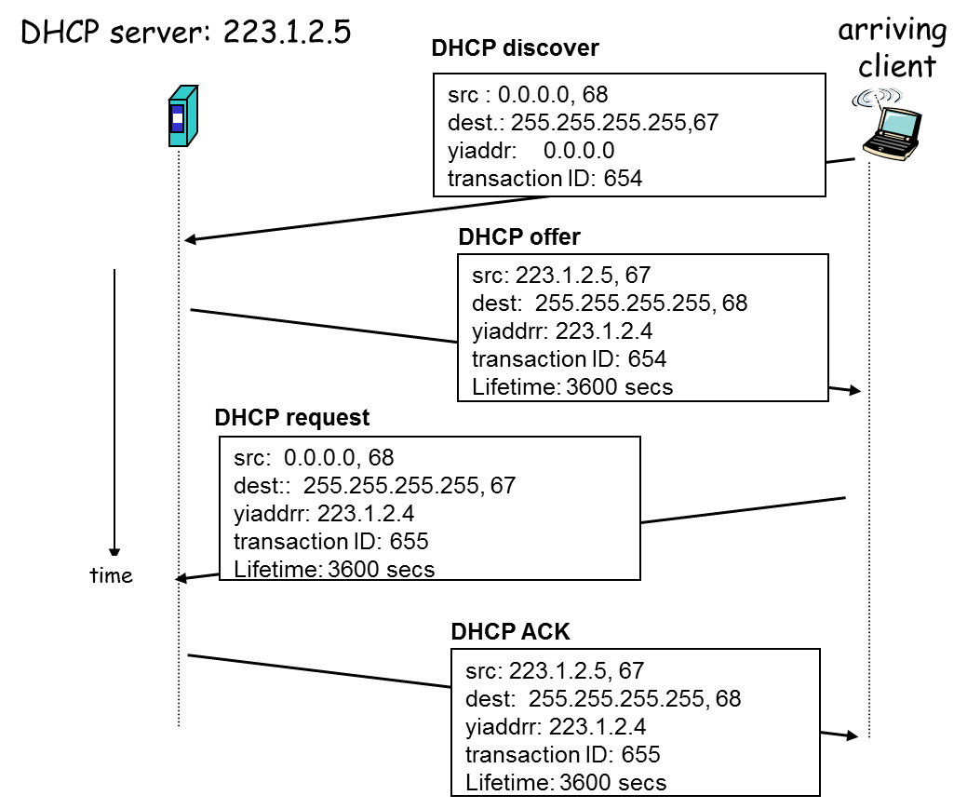
DHCP client-server scenario

Slide 5

Summary
DHCP

